Slide 1
CCNA
Cisco Certified Network Associate

Slide 2

Course Introduction

Slide 3

Cisco Career Certifications
CCNA Exam 640-802
Expert
Required Exam
Recommended Training Through
Cisco Learning Partners
CCIE
Professional
CCNA
Cisco Certified Network Associate
CCNP
INTRO and ICND
Introduction to Cisco Networking Technologies and Interconnecting Cisco Network Devices
Associate
CCNA
http://www.cisco.com/go/certifications
Notes:
Lesson Aim
<Enter lesson aim here.>

Slide 4
How to be CCNA certified ?
Option 1
Pass the CCNA exam 640-802
(60-70 questions in 2 hours)
Option 2
Pass the INTRO exam 640-822
(40-50 question in 1.5 hours)
+
Pass the ICND exam 640-816
(40-50 question in 1.5 hours)

Slide 5
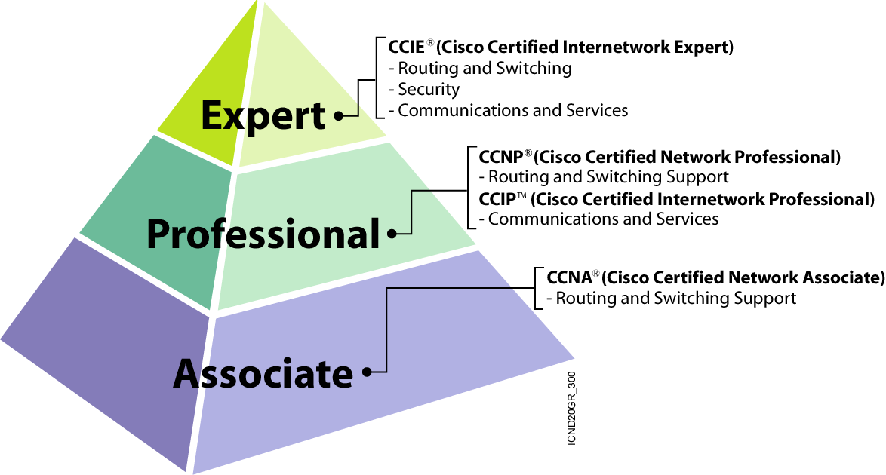
Cisco Different Certifications Fields
CCIE Routing
and Switching
CCDE
CCIE
Service Provider
CCNP
CCNP
CCIP
CCNA
CCDA
&
CCNA
CCNA
Network Implementation
Network Design
Network Service Provider
CCIE
Security
CCIE
Voice
CCIE
Service Provider
CCIE
Storage Networking
CCSP
CCVP
CCIP
CCNP
CCNA Voice
&
CCNA
CCNA
CCNA Security
&
CCNA
CCNA
Network Security
Voice Networks
Storage Networking

Slide 6
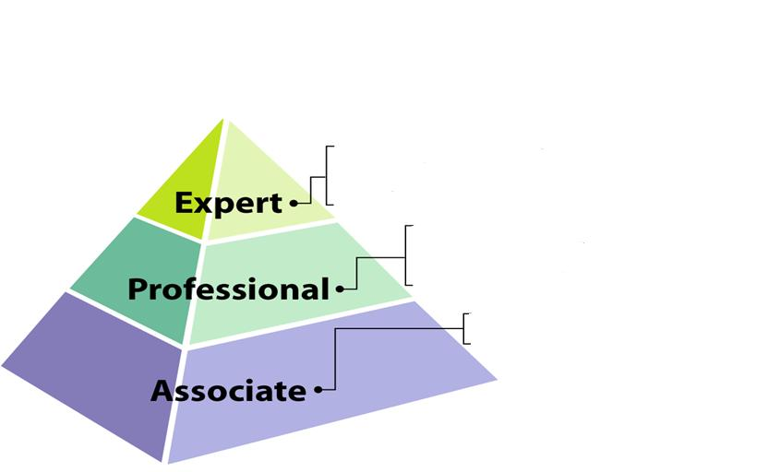
New Cisco Certification Path
CCIE Wireless
Coming Soon
CCNA Wireless

Slide 7
Course Topics
Introduction
  Network introduction.
  TCP\IP Vs OSI.
  Cisco Routers & Basic configuration.
Routing Concepts & Routing Protocols.
  Routing Concepts
  Routing Protocols
    Static Routing & Default Routing
    RIP v1 & RIP v2
    EIGRP
    OSPF

Slide 8
Course Topics
Switching & LAN Design
  LAN Design
  Switching concepts
  Switching Protocols (VLAN,VTP,STP, Inter-VLAN Routing)
  WLAN
WAN Technology
  WAN Introduction.
  HDLC , PPP
  Frame Relay
  Network Security (Access Control List)
  IP addressing services (DHCP , NAT, NAT overload)
  WAN Advanced Technology (Tele-worker Solution & IPV6)

Slide 9
Networking Technologies
Network:
Group of components or devices connected together to give the user a certain service (application).
Importance of Networks:
  Easy access and sharing of information
  Sharing of expensive devices and network
  resources
  Modern Technologies (IP telephony, Video
  Conferencing, ….etc)

Slide 10
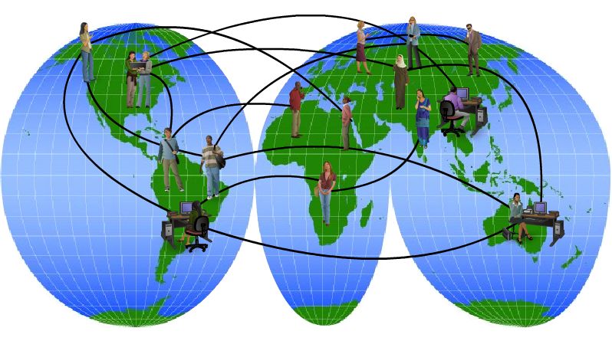
Networks Support the way we live

Slide 11

Networks Support the way we live

Slide 12
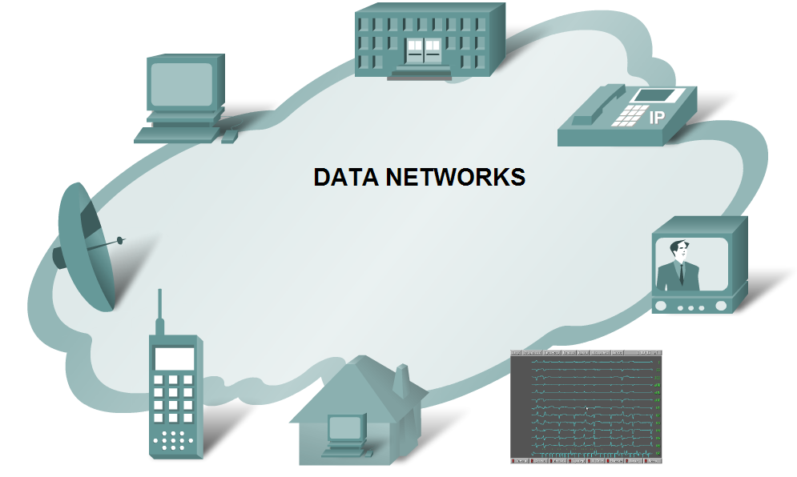
DATA NETWORKS

Slide 13
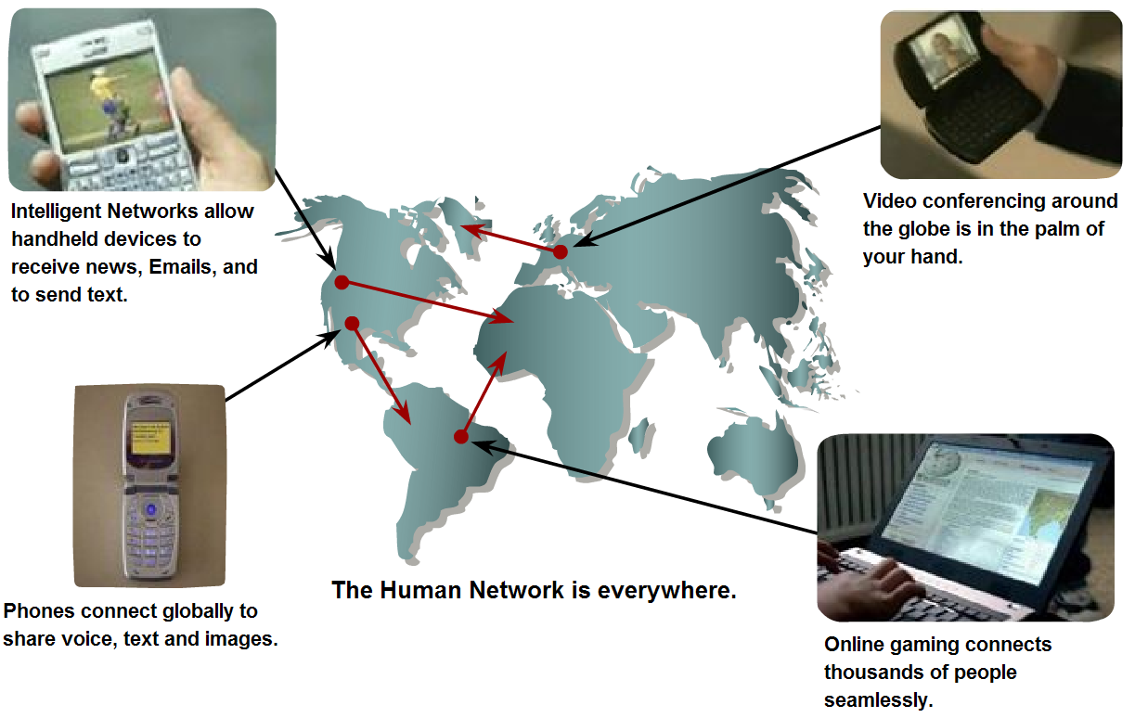
HUMAN NETWORK

Slide 14
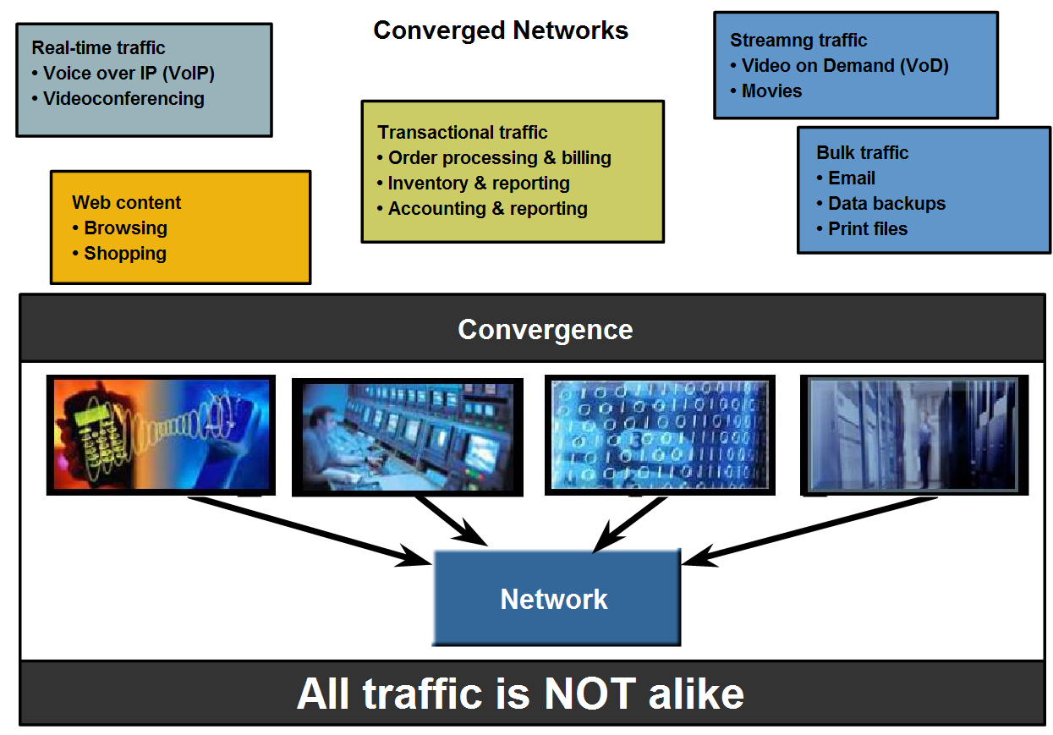
Converged Network

Slide 15
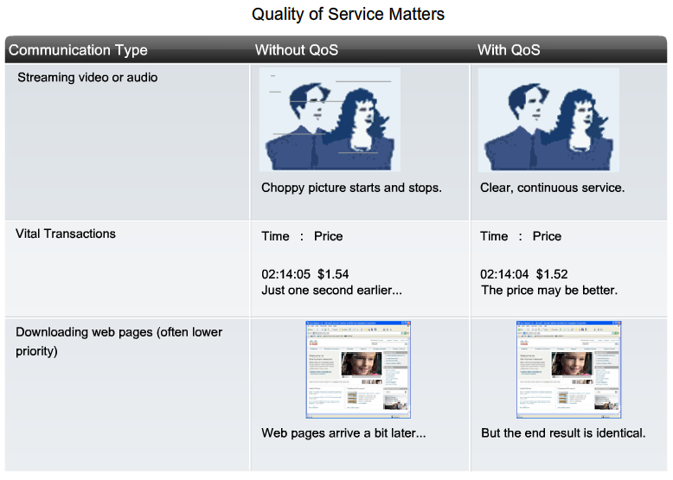
Quality Of Service

Slide 16
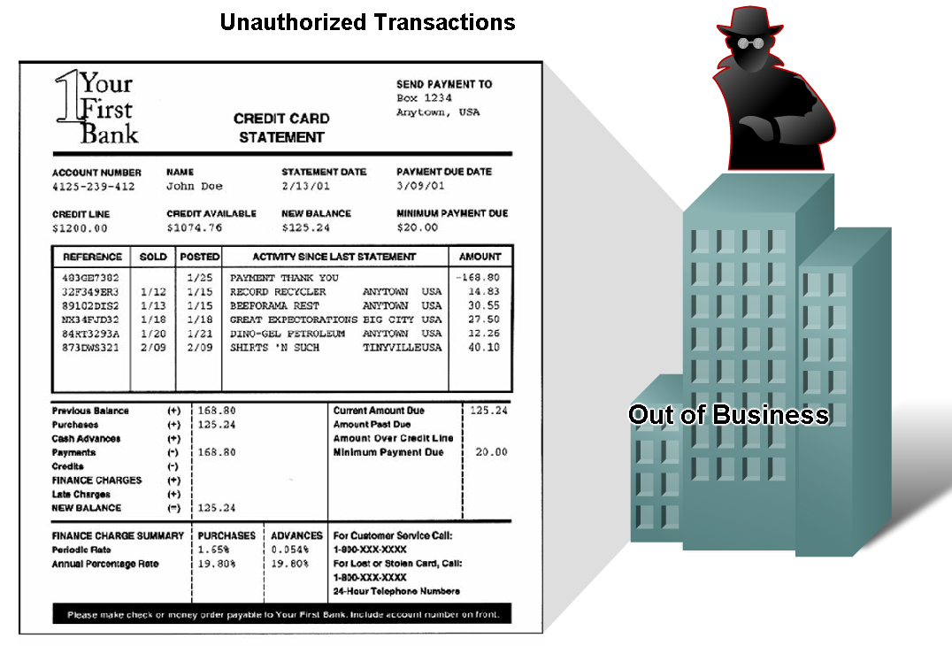
Need for secure network

Slide 17
Network components
Network has three main components
  Computers (servers and hosts)
  - Source of applications (network aware applications)
  - ex: HTTP (Hyper Text Transmission Protocol),
  FTP (File Transfer Protocol),
  SMTP (Simple Mail Transfer Protocol)
  POP3 (Post Office Protocol 3)
  Telnet
  Network Devices
  - Devices that interconnect different computers together
  - ex: Repeaters, hub, bridge, switch, router, NIC and modems
  Connectivity
  - Media that physically connect the computers and network devices
  - ex: Wireless and cables

Slide 18
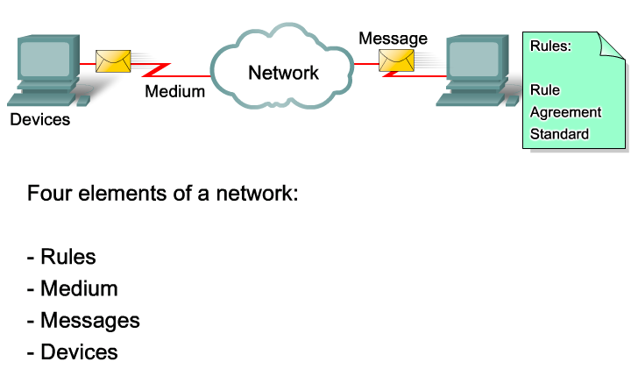
Elements Of Network

Slide 19
Network Types
LAN (Local Area Network):
  It is a group of network components that work within
  small area
  Ex.: Token Ring, FDDI, Ethernet, Fast Ethernet,..
MAN (Metropolitan Area Network):
  It is a group of LANs that are interconnected over a small
  area within city like Cairo.
  Ex.: Metro Ethernet.
WAN (Wide Area Network):
  It is a group of LANs that are interconnected within large area.
  Ex.: FR, ISDN,X.25, Analog dialup, ATM.

Slide 20
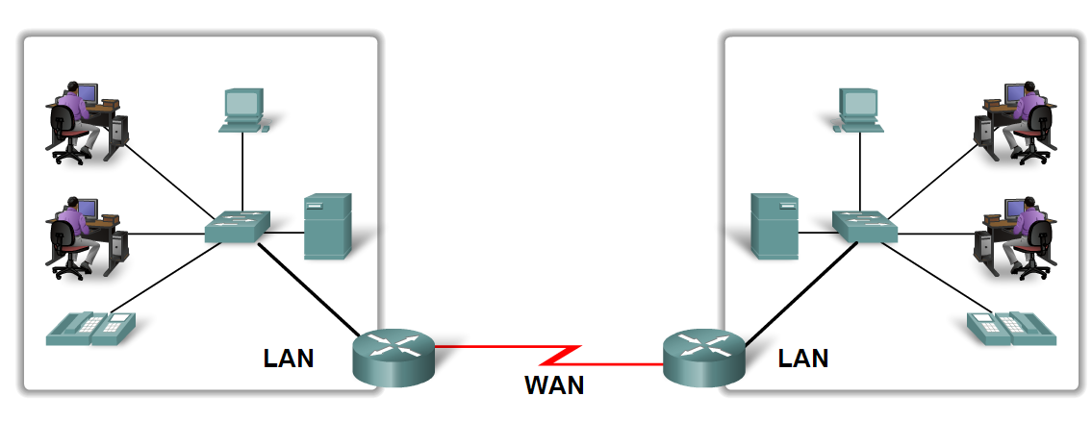
LAN & WAN

Slide 21
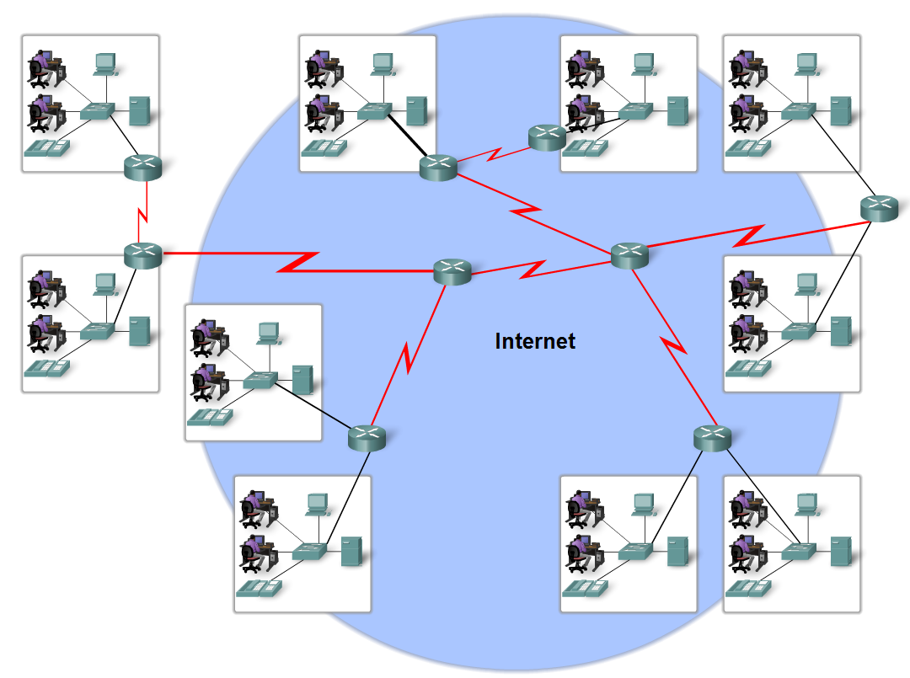
Internet

Slide 22
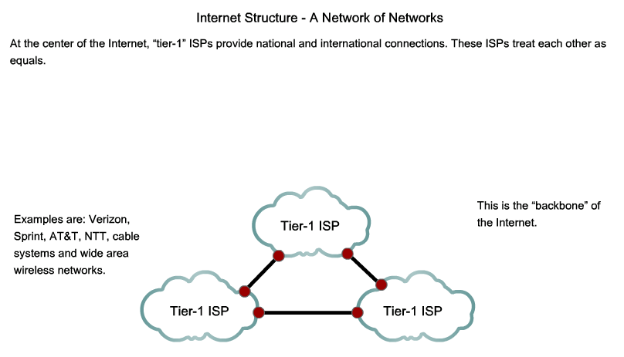
Internet

Slide 23
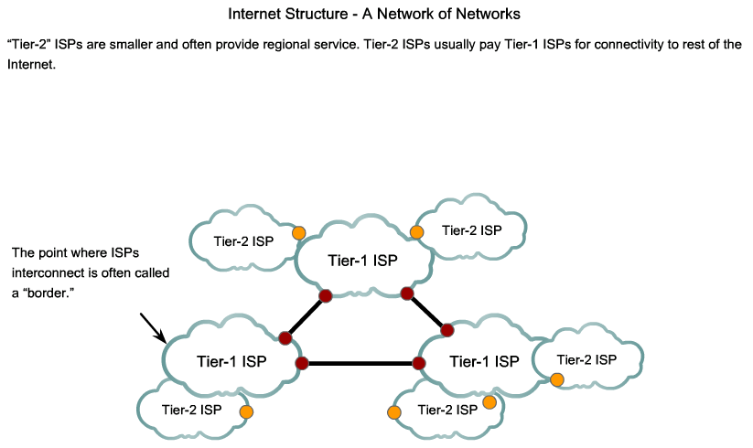
Internet

Slide 24
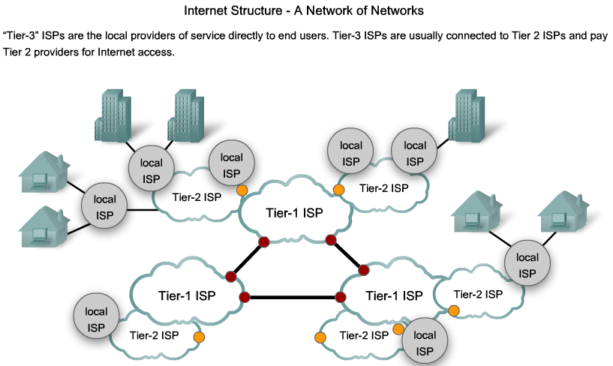
Internet

Slide 25
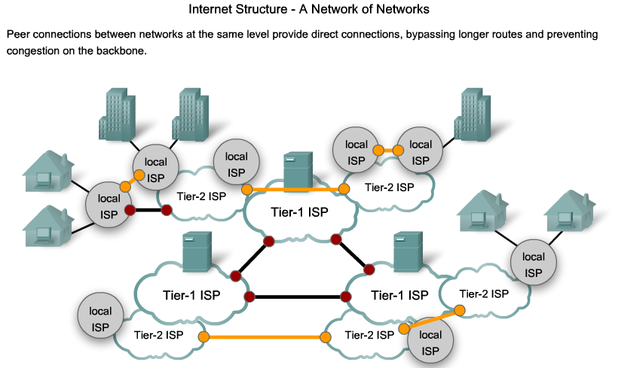
Internet

Slide 26
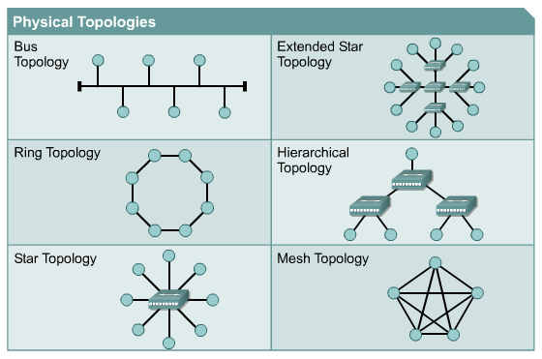
Network Topologies
Topology:
How devices are connected together
  Physical Topology: It describes how devices are physically cabled
  Logical Topology: It describes how devices communicate across
  physical topology.

Slide 27
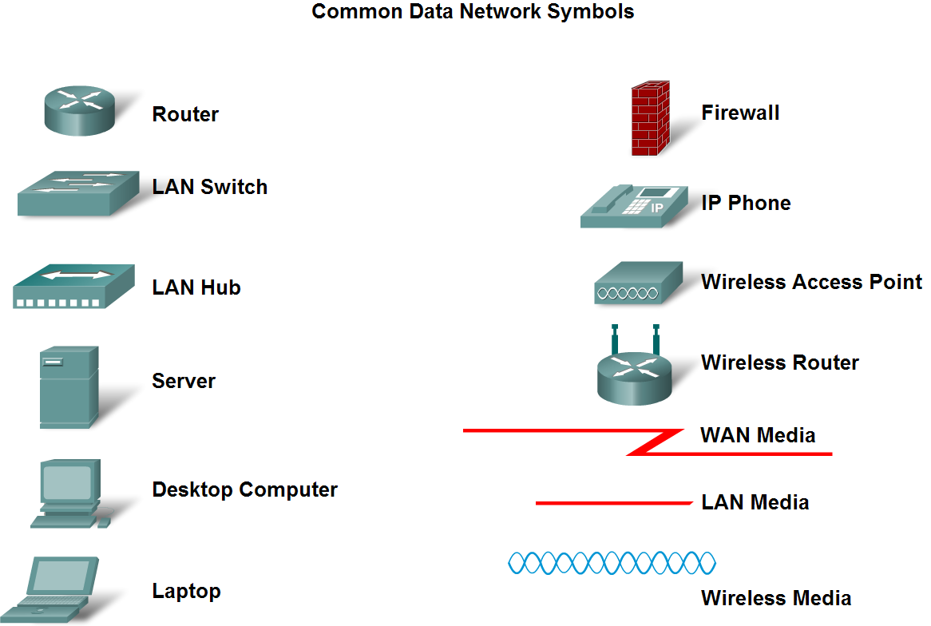
Cisco symbols

Slide 28
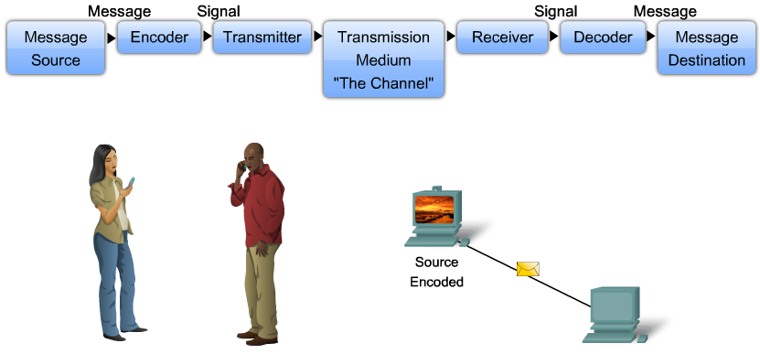
The elements of communication

Slide 29
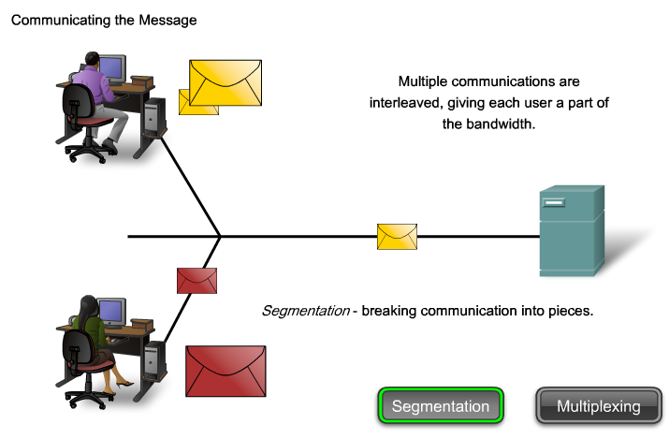
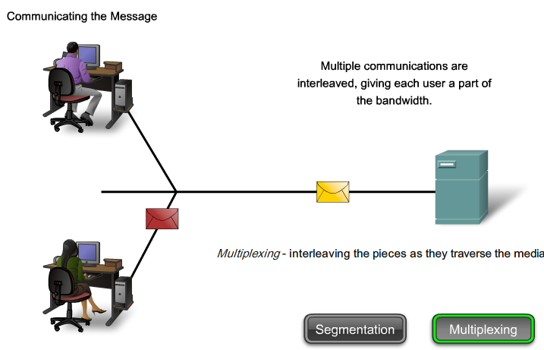
The elements of communication

